Slide 1
CIS 4526 Foundations of Machine Learning
Chapter 16
Deep Learning for Computer Vision

Slide 2
Outline
Overview
Computer Vision without Deep Learning
Filter
Computer Vision with Deep Learning
Basic Ideas
Convolution
Pooling
Fully Connected Layer

Slide 3
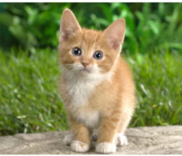
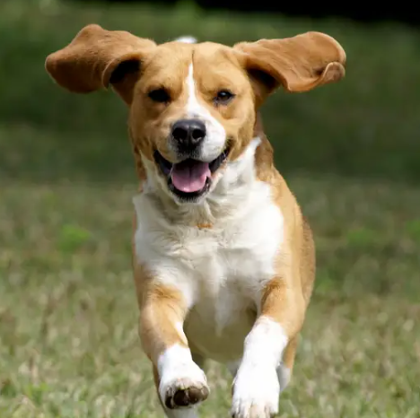
Deep Learning for Computer Vision
It is where it all started
To decide which one, a dog or a cat you want to adopt as a pet

Slide 4
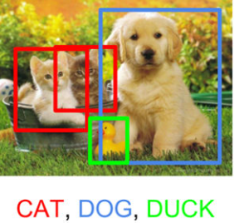
The Good, The Bad and the Ugly

Slide 5
But it takes over 300 years from Isaac Newton time for a machine to do the same thing
Cat vs Dog
A 3 years old kid can tell a dog from a cat
Why it is so hard?

Slide 6
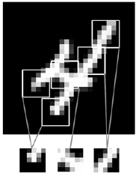
Why it is hard for a computer to recognize an object in an image?
The classification of an image can be defined by if the image has the required features of the object (like a long flat surface in a bridge or the wheel in a car)
However, the feature of a particular object cannot be easily expressed in an absolute manner.
They can be shifted, scale in and scale out, rotated and the proportion between different part can vary.
Just compare your handwriting with your classmates
They can be easily recognized by a human being, but very difficult to “program” the “rules” (if any) into a traditional expert systems
Feature of an image
Images can be broken into local patterns such as edges, textures, and so on

Slide 7

Solution is Convolutional Neural Network, but what is a CNN?
Convolute => Activate => Pooling => Convolute => Activate => Pooling => …. => Fully Connected output layer

Slide 8
Before you learn how to run, learn how to walk first
Computer Vision without Deep Learning

Slide 9
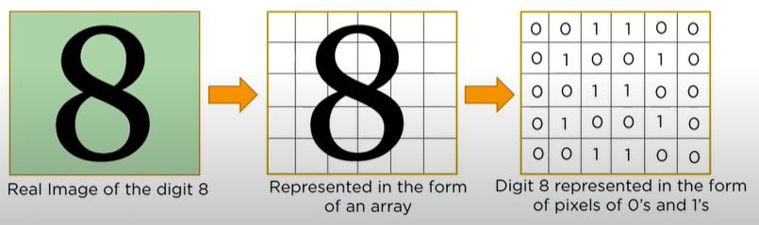
Back to Basics. What is an Image?
Most basic image: Handwritten digits (The Hello World example)
An image is just a 2-dimensional array of pixel values
For gray scale images, the value is between 0 to 255
For color images, the value can be consisted of 3 tuple from 0 to 255 (255, 255, 255) for capturing the Red, Green and Blue components

Slide 10
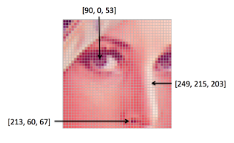
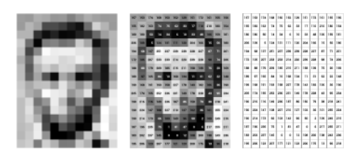
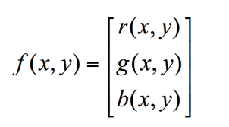
Back to Basics. What is an Image?
An image is just a matrix of pixel values
f (x, y ) = function at x, y of values between 0 to 255 for gray scale image with 0 being black and 255 being white (using 8 bits for an integer)
For color image, f(x, y) will be multi-value functions for capturing the RGB components

Slide 11
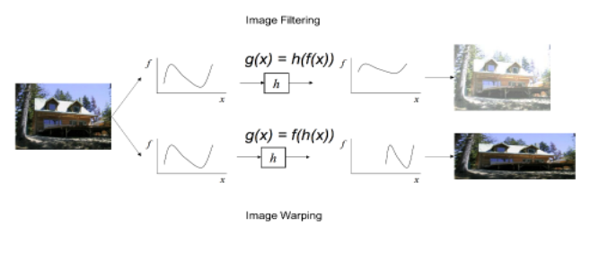
Image Processing now means applying transformation of the f(x,y) function

Slide 12
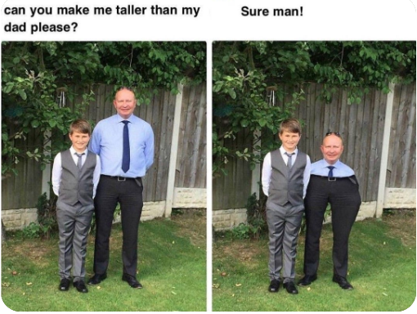
Asking a Photoshop guru to fix your photo

Slide 13
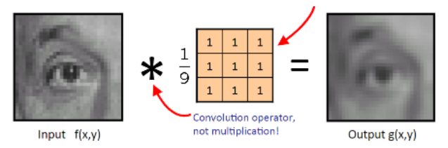
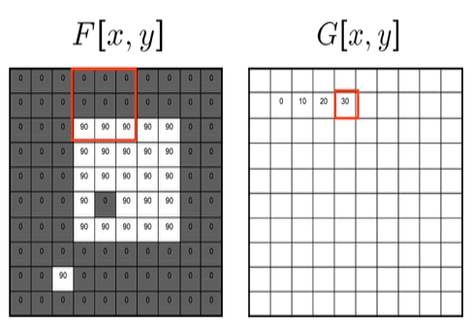
What is a Filter?
A filter is a small n x n matrix (usually 3x3) that can be applied to the pixel values of a local section of an image.
Sliding a 3x3 window throughout the whole images
Example a 3x3 moving average filter
End effect is smoothing the images => Blurring filter
https://ai.stanford.edu/~syyeung/cvweb/tutorial1.html

Slide 14
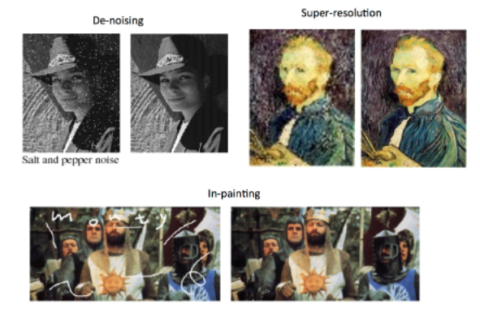
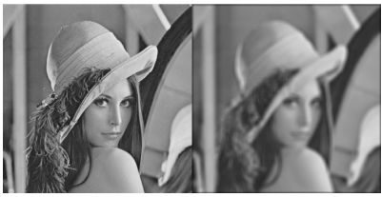
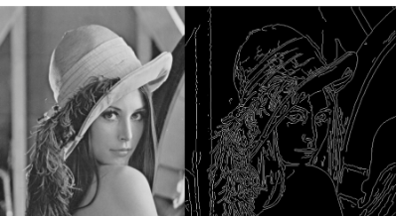
What is a Filter?
The goal of using filters is to modify or enhance image properties and/or to extract valuable information from the pictures such as edges, corners and blobs.
Blurring
Identifying edges

Slide 15
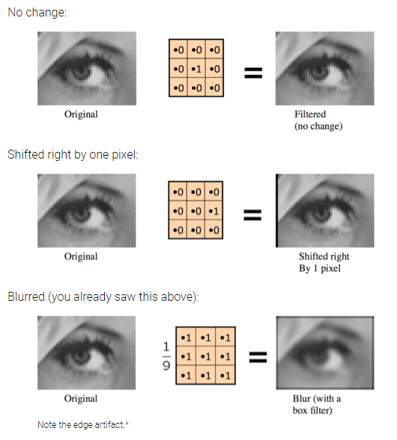
Other types of Filters

Slide 16
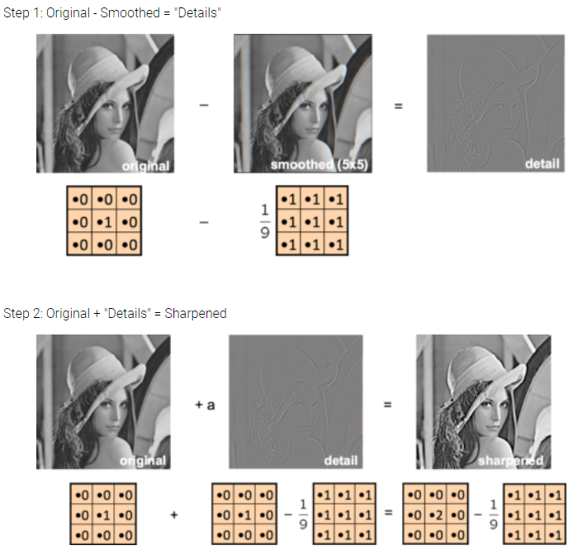
A Sharpening Filter

Slide 17
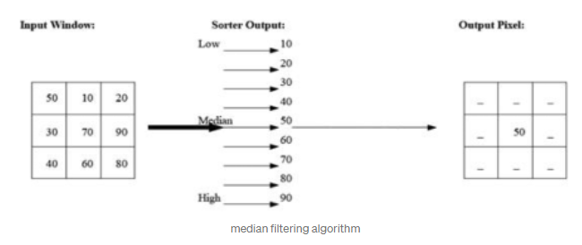
A median filter
Instead of using the mean, one can use the median of the neighboring pixels result in a smoothing non-linear filter which can be used to reduce impulse noise (aka salt-and-pepper noise)

Slide 18
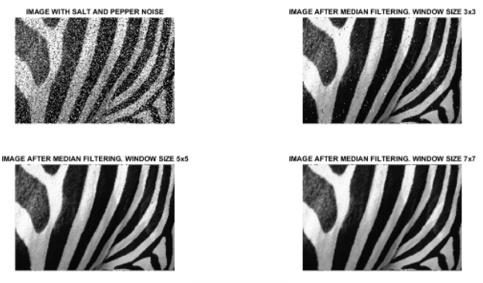
What can a median filter achieve? Answer is: A LOT

Slide 19
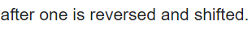
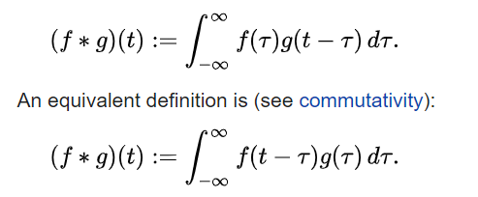
Mathematical representation
Remember an image is simply a f(x, y)?
Applying a Filter, g(x,y) on top of f(x, y) is mathematically called a Convolution operation
An image filter is a 2D Convolution operation

Slide 20
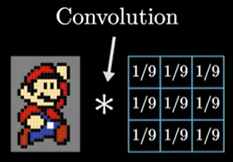
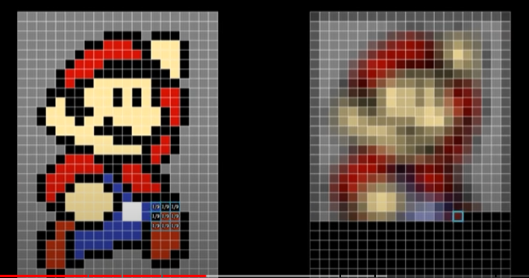
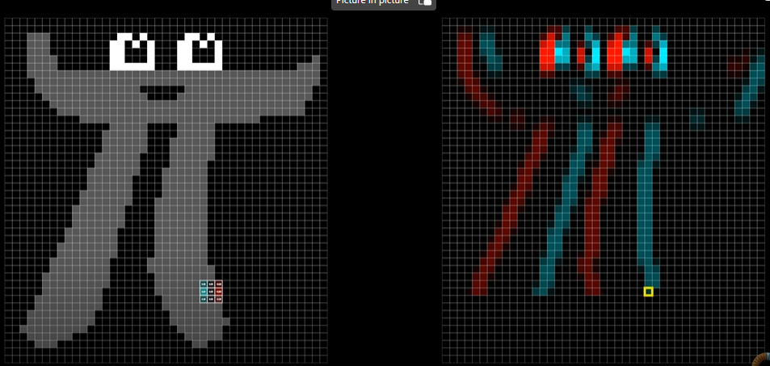
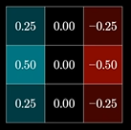
More examples
Ref: But what is a convolution?
Blurring
(from 8:30)
Filter for picking up vertical edges
(from 12:00)

Slide 21
Outline
Overview
Computer Vision without Deep Learning
Filter
Computer Vision with Deep Learning
Basic Ideas
Convolution
Pooling
Fully Connected Layer

Slide 22
How do Deep Learning recognize images
Remember we call attributes as features in machine learning?
Remember the essence of machine learning when compare with traditional expert systems in AI where the emphasis was knowledge representation is automated feature engineering?
In computer vision, recognizing an image requires capture of specific features of an object (such as a Cat) which translates into locating and identifying edges, corners, certain shapes?
The main idea is to use Neural Network to automatically learn the values of the Filters in various part (ie local area) of the picture

Slide 23
How do Deep Learning recognize images
Apply well-defined filter means identifying and isolating important features of the image
Use neural network to automatically discover the appropriate filters to fit the label means we rely the neural network to discover what are the best features that characterize the object.
A convolution is the simple application of a filter to an input that results in an activation. Repeated application of the same filter to an input results in a map of activations called a feature map, indicating the locations and strength of a detected feature in an input, such as an image.
The innovation of convolutional neural networks is the ability to automatically learn a large number of filters in parallel specific to a training dataset under the constraints of a specific predictive modeling problem, such as image classification. The result is highly specific features that can be detected anywhere on input images.

Slide 24
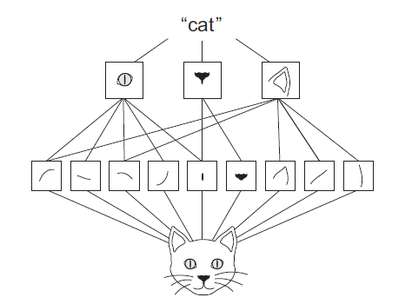
How do Deep Learning recognize images
Convolute => Activate => Pooling
Convolute => Activate => Pooling
…
Fully Connected
Output
Convolute: Discover filter to identify feature
Activate: Pick only the ones that are important
Pooling: Reduce overfitting, solve the translation and rotational invariant challenge
FC: Standard Neural Network ways of fitting

Slide 25
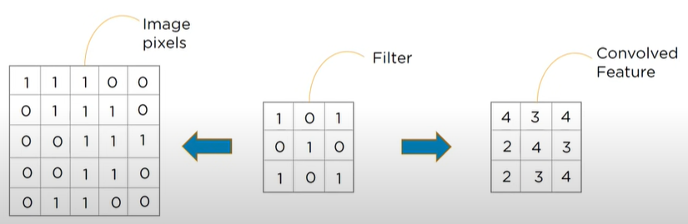
Convolution
Convolutional layers are comprised of filters which is a small window (usually 3x3) that slide through the input image (input feature map) to generate a small size output feature map.
The distance that filter is moved across the input map from previous layer activation is referred to as the stride which is usually 1 by default. A stride of 2 with a 2x2 filter will guarantee that there is no overlap
If the size of the previous layer is not divisible by the size of the filters receptive field, one may need to provide zero padding to avoid reading off the edge of the input feature map
Example: work this out yourself to see if you can compute the output as shown
<= Also called output feature map
https://www.youtube.com/watch?v=Jy9-aGMB_TE&ab_channel=Simplilearn start from 11:00

Slide 26
Convolution
Quick Review Question
Applying a 3x3 filter onto a 5x5 input feature map will produce a 3x3 output feature map
What is the size of the output feature map on a 28x28 input feature map with a 3x3 filter?
Answer: 26x26
If we continue to feed the above output feature map with a 5x5 filter with stride 1, what’s the size of the output feature map after applying the 5x5 filter in the next step?
Answer: 24x24

Slide 27
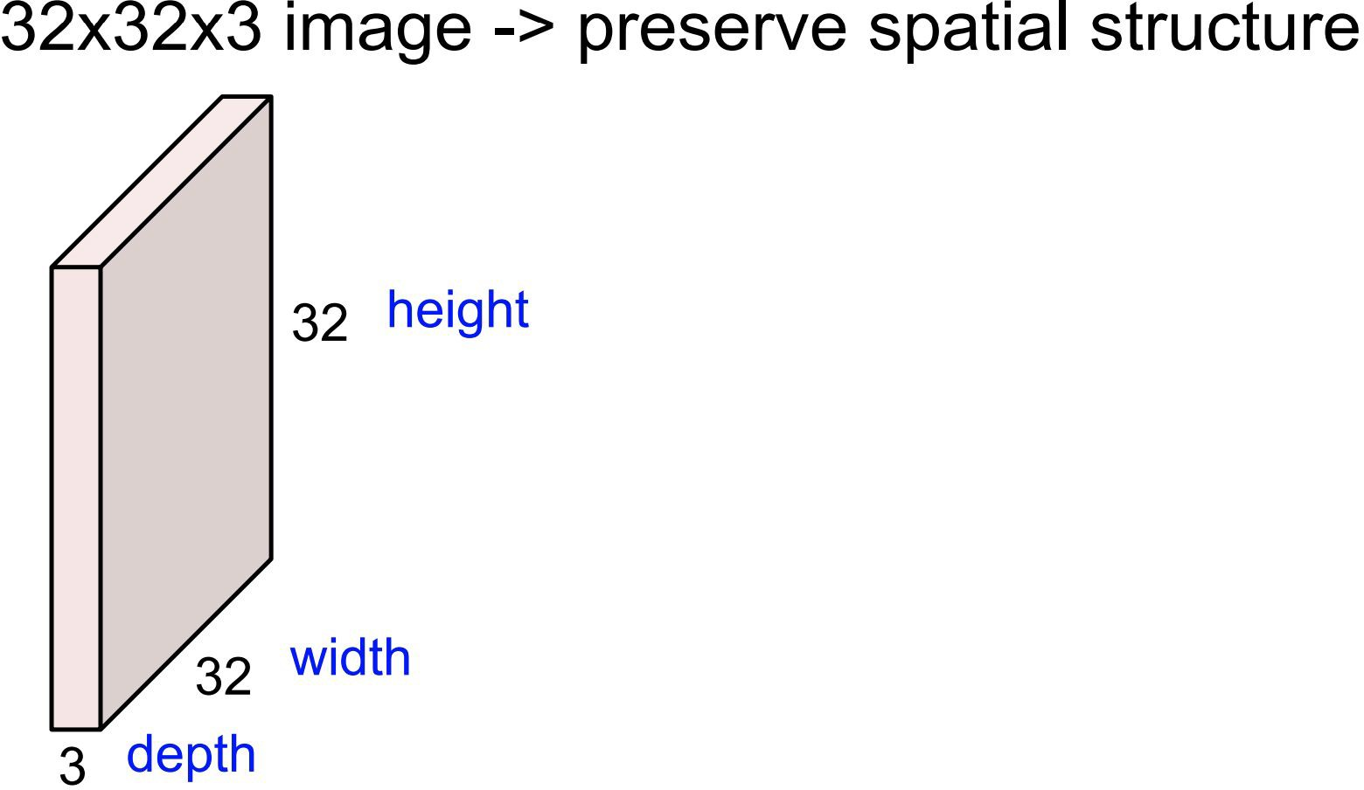
Convolution with depth (RGB)

Slide 28
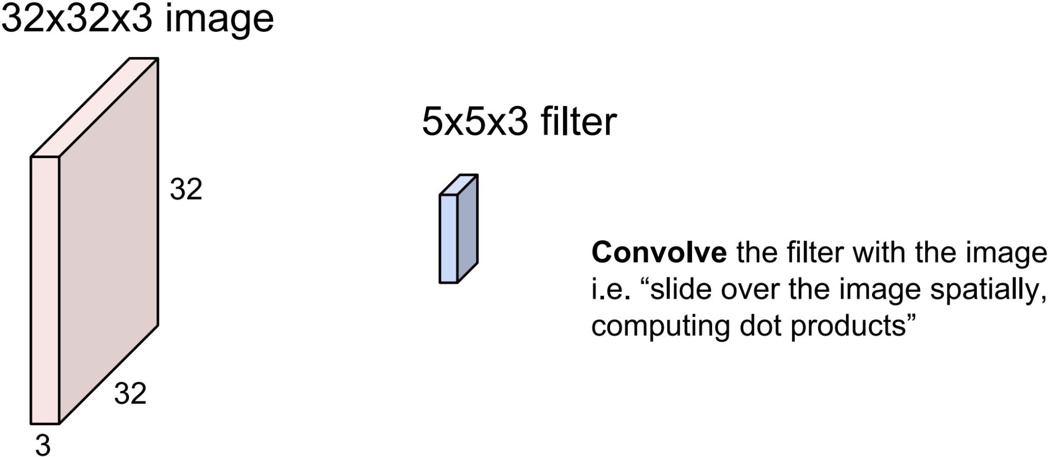
Convolution Layer

Slide 29
Convolution Layer
In MLP, weights should have the same size as the inputs, but convolution uses much smaller size of weights.

Slide 30
Convolution Layer
Filters always extend the full depth of the input volume

Slide 31
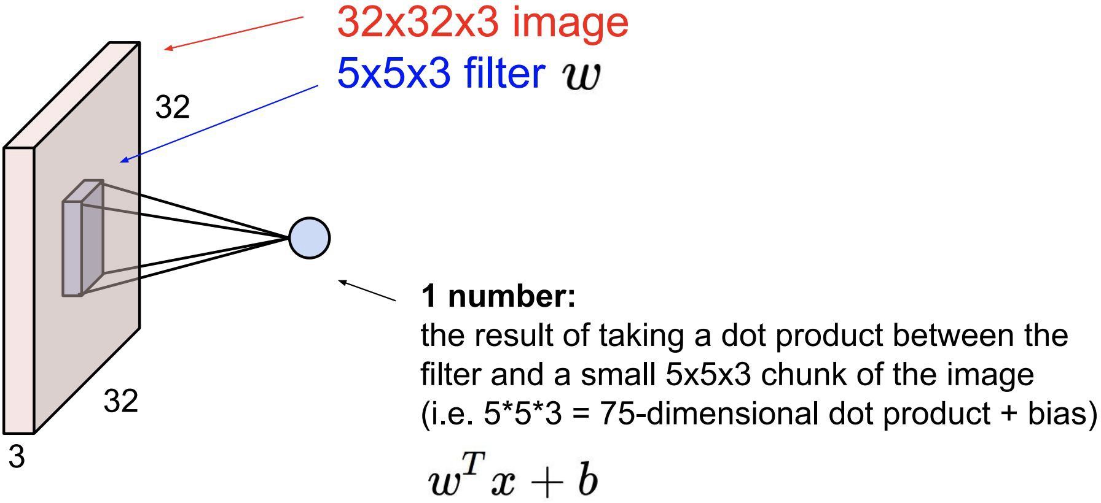
Convolution Layer

Slide 32
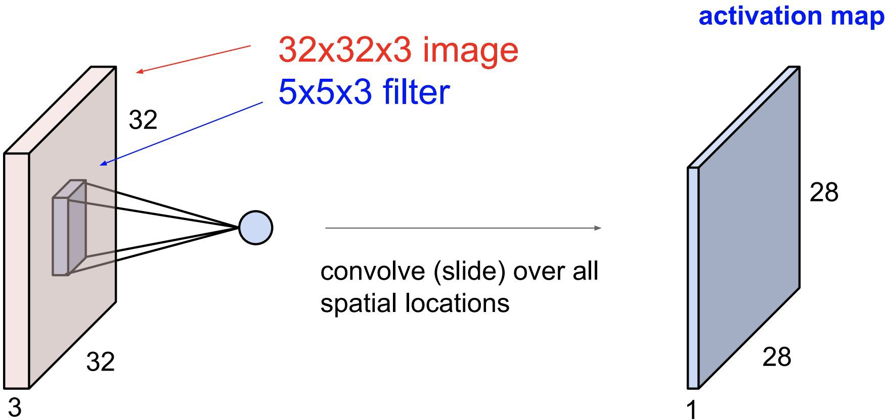
Convolution Layer

Slide 33
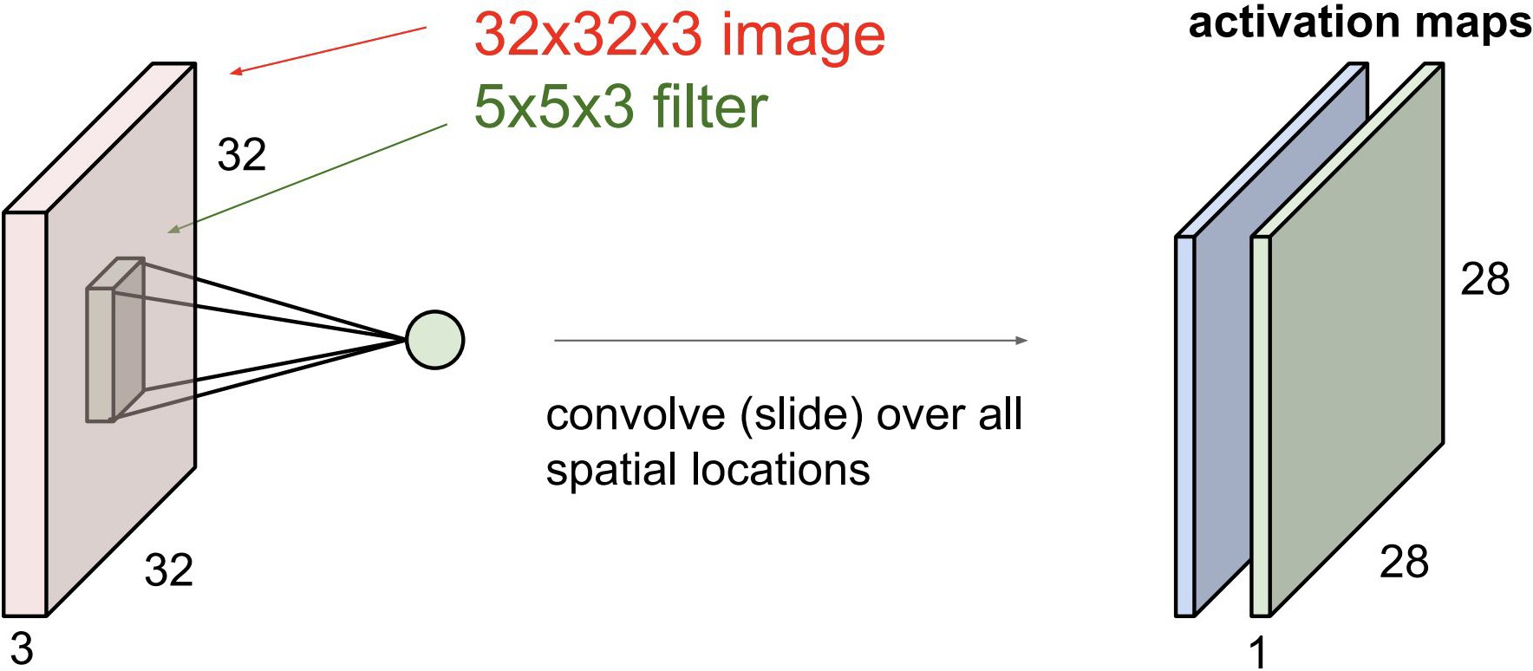
Convolution Layer
consider a second, green filter

Slide 34
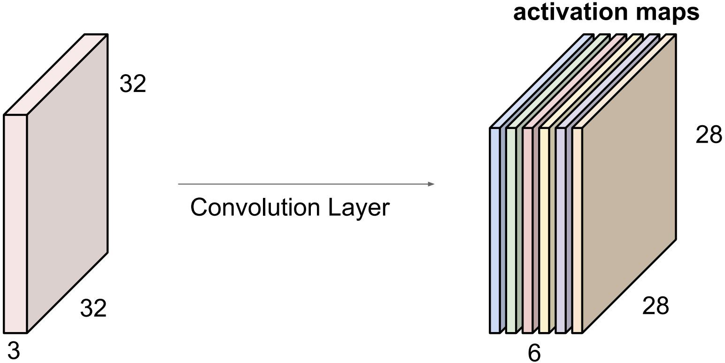
Convolution Layer
For example, if we had 6 5x5 filters, we’ll get 6 separate activation maps:
We stack these up to get a “new image” of size 28x28x6!

Slide 35
Outline
Overview
Computer Vision without Deep Learning
Filter
Computer Vision with Deep Learning
Basic Ideas
Convolution
Pooling
Fully Connected Layer

Slide 36
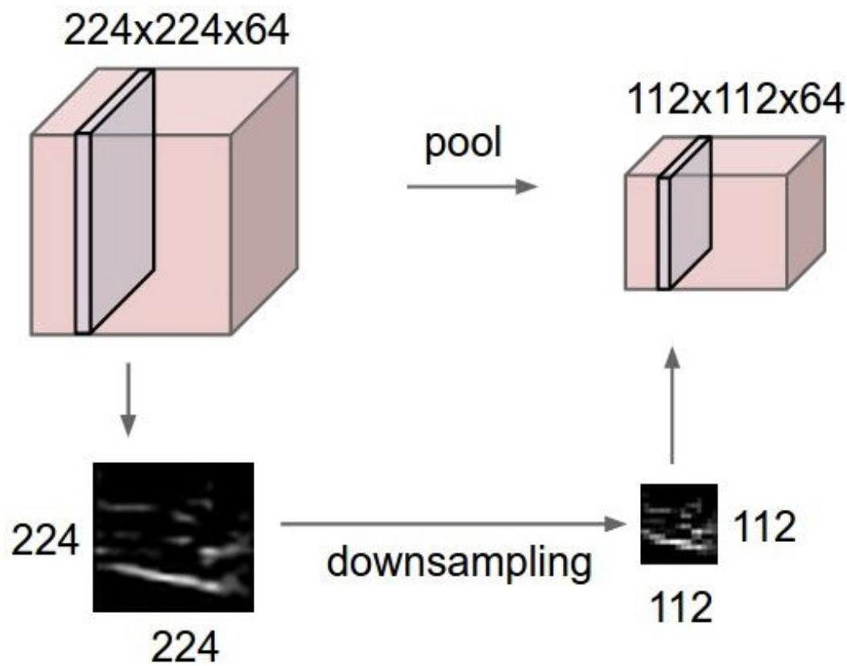
Pooling
Select the most representative features for the next step
Operates over each activation map independently:

Slide 37
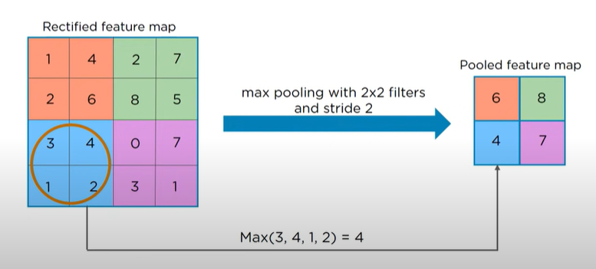
Pooling
The pooling layers down-sample the previous layers rectified feature map
Common pooling: Max Pooling (most popular), Average Pooling

Slide 38
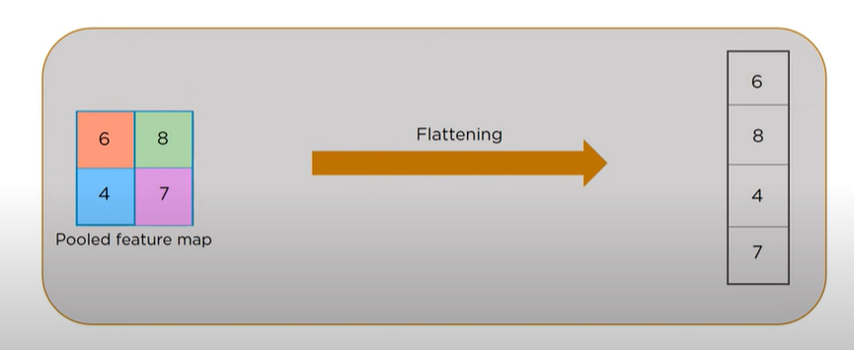
Flattening
Flattening is the process of converting all the resultant 2 dimensional arrays from pooled feature map into a single long continuous linear vector

Slide 39
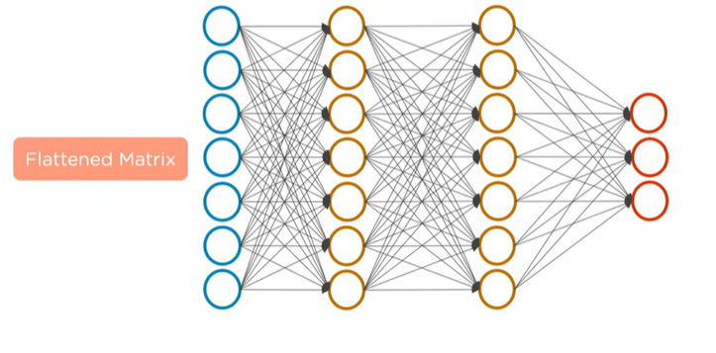
Fully Connected Layer

Slide 40
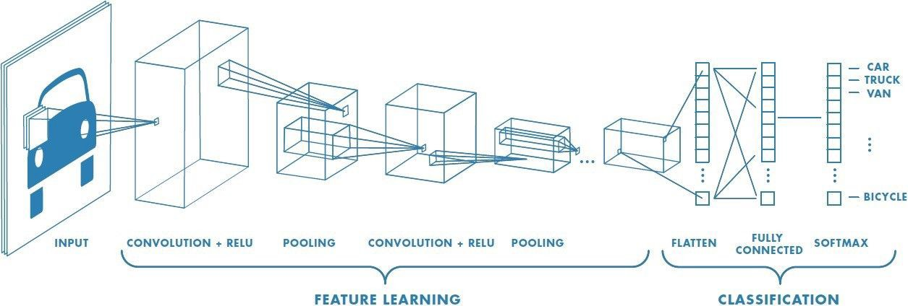
Fully Connected Layer (FC Layer)

Slide 41


Convolutional Neural Network
What if I ask you to implement CNN from scratch

Slide 42
Convolutional Neural Network
Learning by doing

Slide 43
Online Resources
https://cs231n.github.io/
https://cs231n.github.io/convolutional-networks/
https://ai.stanford.edu/~syyeung/cvweb/tutorial1.html
https://machinelearningmastery.com/crash-course-convolutional-neural-networks/
https://medium.com/@boelsmaxence/introduction-to-image-processing-filters-179607f9824a
https://towardsdatascience.com/image-processing-and-pixel-manipulation-photo-filters-5d37a2f992fa
https://www.youtube.com/watch?v=Jy9-aGMB_TE&ab_channel=Simplilearn

